Slide 1

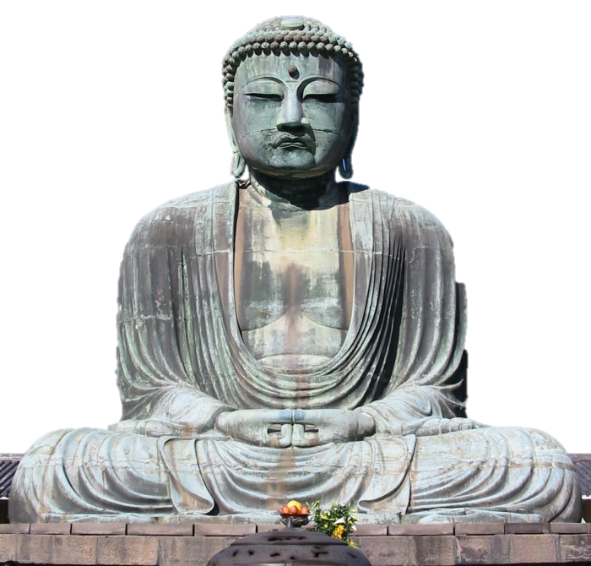

Slide 2
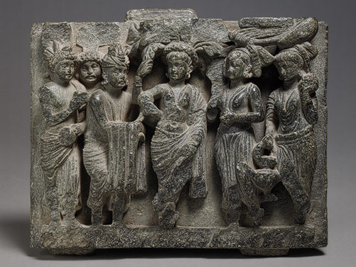
Birth of the Buddha, Kushan period

Slide 3
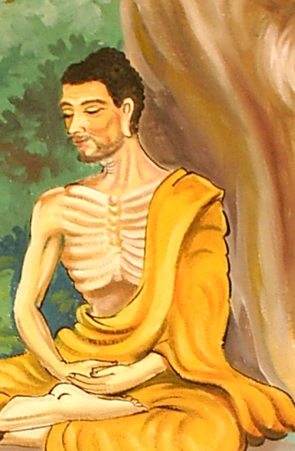
Siddhartha Gautama
Born into a noble family that lived near the Himalayas (Nepal)
He led a sheltered life, at 29 he ventured outside the palace
  Saw death (decaying corpse) and pain (diseased man)
He decided to spend his life searching for religious truth and to end life’s suffering

Slide 4
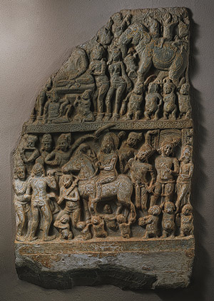
The Great Departure and the Temptation of the Buddha, Ikshvaku period, ca. first half of 3rd century
India

Slide 5
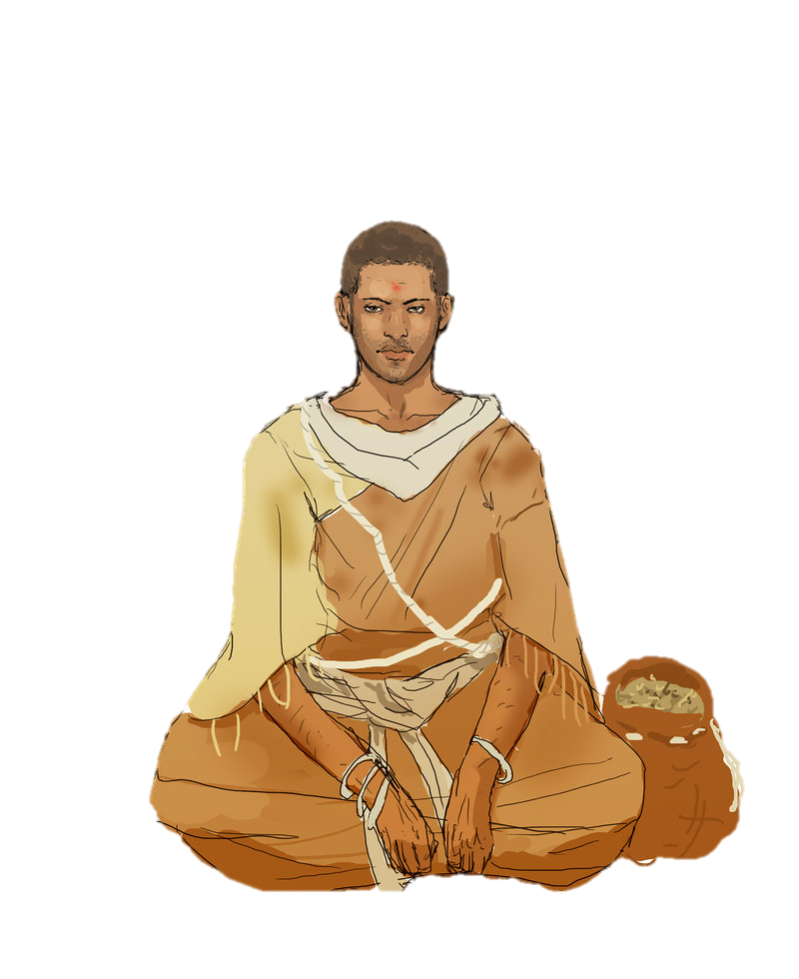
Siddhartha’s Quest
Wandered across India for 6 years and tried many ways of reaching enlightenment (fasting, seeking religious teachers, etc).
Finally he meditated under a fig tree. After 49 days of meditation he achieved an understanding of the cause of suffering
Soon after he gave his first sermon and laid out the foundational teachings of what would become Buddhism

Slide 6
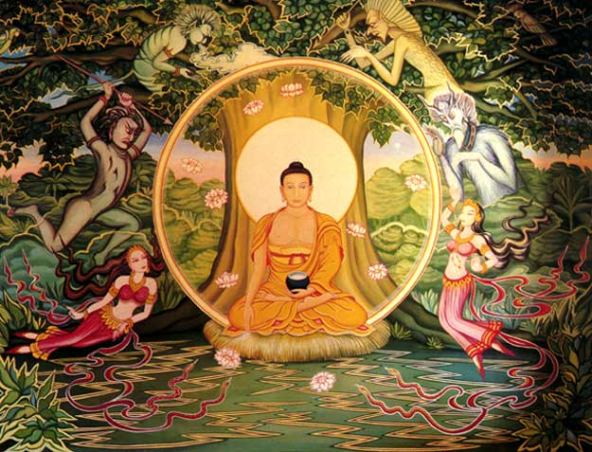

Slide 7
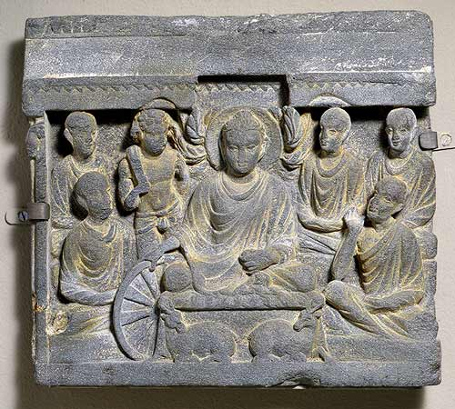
Buddha's First Sermon at Sarnath, Kushan Period, ca. 3rd century
Pakistan

Slide 8
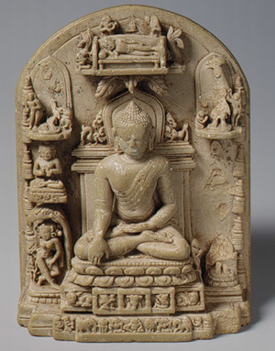
Plaque with scenes from the life of the Buddha, Pala or Pagan period, 12th century
India or Burma

Slide 9
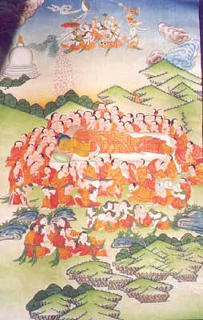
Death of the Historical Buddha (Nehan), Kamakura period (1185–1333),

Slide 10
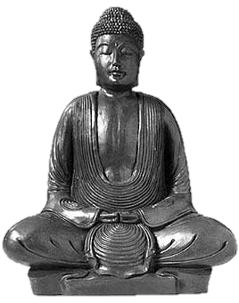
Buddhism’s Four Noble Truths
There is Suffering. Suffering is common to all.
2. Cause of Suffering. We are the cause of our suffering.
3. End of Suffering. Stop doing what causes suffering.
4. Everyone can be enlightened by taking the 8 Fold path

Slide 11
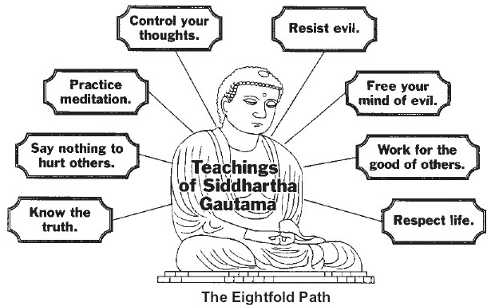
The Noble Eightfold Path

Slide 12
The Noble Eightfold Path
Right View. The right way to think about life is to see the world through the eyes of the Buddha--with wisdom and compassion.
Right Thought. We are what we think. Clear and kind thoughts build good, strong characters.
Right Speech. By speaking kind and helpful words, we are respected and trusted by everyone.
Right Conduct. No matter what we say, others know us from the way we behave. Before we criticize others, we should first see what we do ourselves.

Slide 13
The Noble Eightfold Path
Right Livelihood. This means choosing a job that does not hurt others. The Buddha said, "Do not earn your living by harming others. Do not seek happiness by making others unhappy."
Right Effort. A worthwhile life means doing our best at all times and having good will toward others. This also means not wasting effort on things that harm ourselves and others.
Right Mindfulness. This means being aware of our thoughts, words, and deeds.
Right Concentration. Focus on one thought or object at a time. By doing this, we can be quiet and attain true peace of mind.

Slide 14
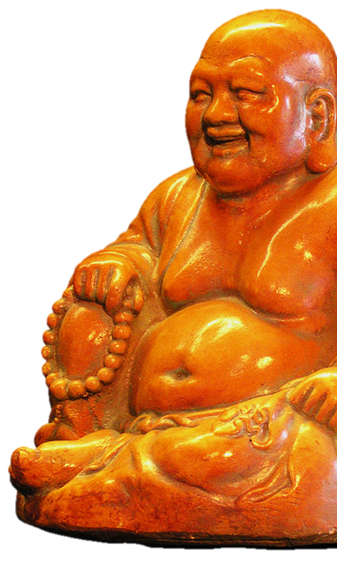
The 5 Principles of Peaceful Coexistence
Refrain from taking life
Refrain from taking that which is not given
Refrain from misuse of the senses
Refrain from telling lies
Refrain from self-intoxication with drink and drugs

Slide 15
Bad Things
THE THREE POISONS:
Moha - ignorance
Raga - greed, lust, craving
dvesh - hatred, anger
THE HINDERANCES:
Sensual desire
ill will
sloth
restlessness and worry
doubt

